Slide 1


DESIGN 1
Lesson 3: Formative Assessment: Website Prototype Review
Ms. Abboud • Grade 9 - Design 1 • Term 1, Week 11

Slide 2
Learning Objectives
WALT - We Are Learning To
WILF - What I'm Looking For
Present my website for peer and teacher review against my design specification.
Record feedback I can act on.
I recorded 2 specific pieces of feedback.
I know what to fix first.

Slide 3
Academic Vocabulary
Prototype
Feedback
An early working version of a product, used for testing and feedback before it is finished.
Specific comments on what works and what to improve.

Slide 4
Frayer Model: Feedback
DEFINITION
CHARACTERISTICS
Specific, useful comments from someone else about how well something is working.
Specific; about how something works; from someone else.
FEEDBACK
EXAMPLES
NON-EXAMPLES
"Your About page link goes to Home, so I couldn't reach About."
A vague comment like "looks cool."

Slide 5
National Identity Integration
UAE Tourism Promotion: tourism teams test their websites with real visitors and improve them. Today your partner is your first visitor.

Slide 6
STARTER
Which Feedback Helps?
'Nice site.'
'Your About page link goes to Home, so I couldn't reach About.'
Which one helps the builder, and why?
Hook • Engage & Ask
5 - 10 minutes

Slide 7
LESSON CORE
I Do: The Prototype Review
Formative rubric: multi-page site 4, navigation 3, consistent design 3.
Accountable Talk stems: 'I noticed...' and 'It would be clearer if...'.
Gradual Release of Responsibility
30 - 40 minutes
1 / 3

Slide 8
LESSON CORE
We Do: Practise Specific Feedback
Turn a vague comment into a specific one together.
A specific comment names the page and gives a reason.
Gradual Release of Responsibility
30 - 40 minutes
2 / 3

Slide 9
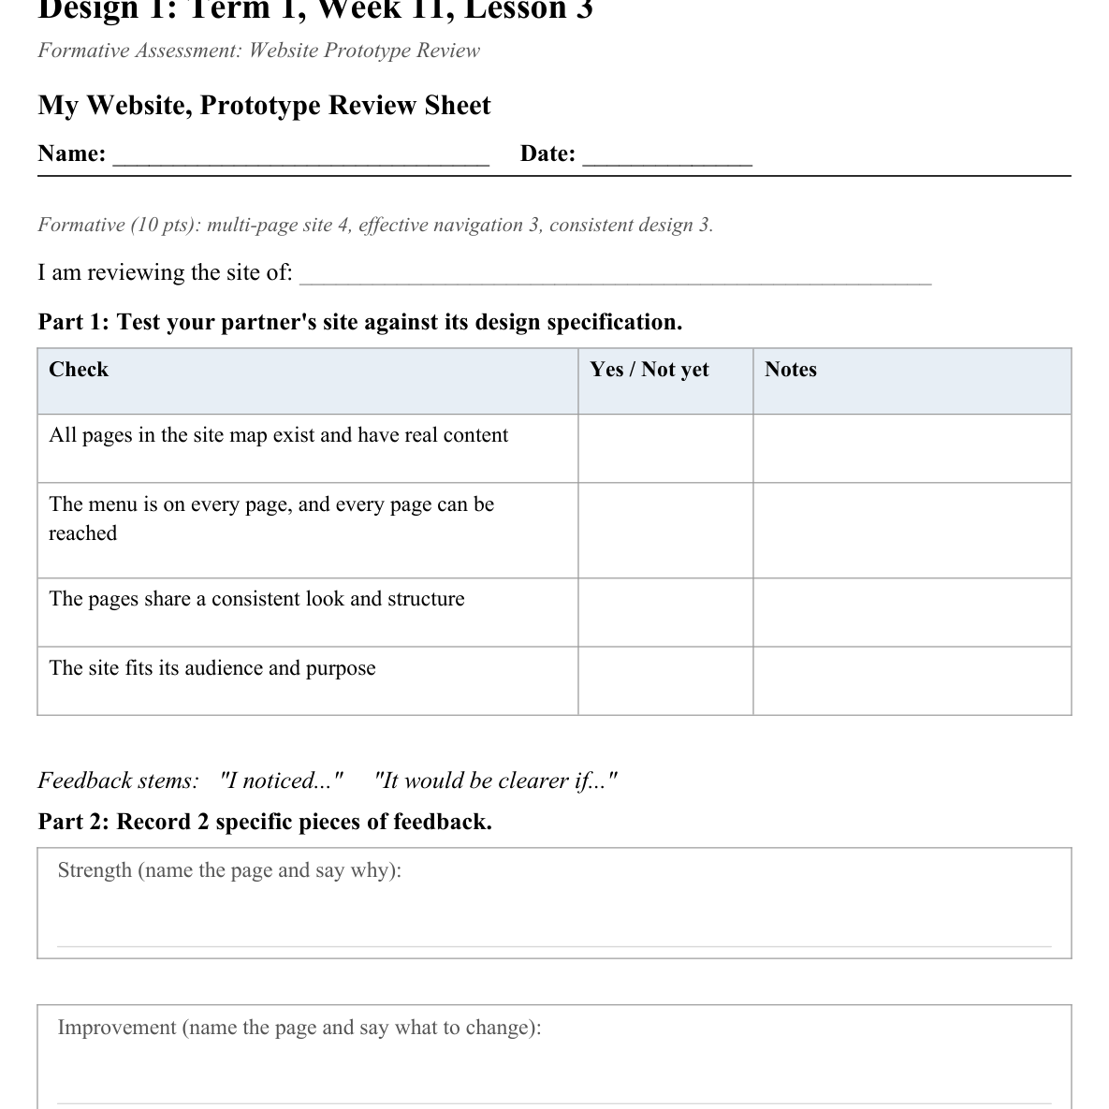
LESSON CORE
You Do: Swap, Test and Record
Swap sites. Test your partner's site against its design specification.
Record 2 pieces of feedback: one strength and one improvement.
Activity: My Website, Prototype Review Sheet
Gradual Release of Responsibility
30 - 40 minutes
3 / 3

Slide 10
CLOSURE
Exit Ticket
What is the first change you will make in the next lesson?
Transition & Extend
5 - 10 minutes

